Slide 1
Announcements
Homework 1 Questions 1-3 posted. Will post remainder of assignment over the weekend; will announce on Slack.
No AI Seminar today.

Slide 3
Homework 1
Introduction to Pacman
Notes:
Switch to Pacman project, discuss code infrastructure, where to look at things, how to do some debugging, etc

Slide 4
Last time: BFS/DFS/UCS
Breadth-first search
Good: optimal, works well when many options, but not many actions required
Bad: assumes all actions have equal cost
Depth-first search
Good: memory-efficient, works well when few options, but lots of actions required
Bad: not optimal, can run infinitely, assumes all actions have equal cost
Uniform-cost search
Good: optimal, handles variable-cost actions
Bad: explores all options, no information about goal location
Basically Dijkstra’s Algorithm! (More on this later)

Slide 5
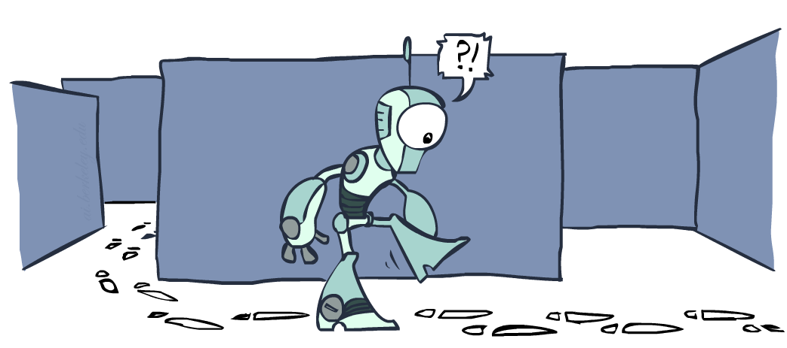
Graph Search

Slide 6
Tree Search: Extra Work!
Failure to detect repeated states can cause exponentially more work.
State Graph
Search Tree

Slide 7
Graph Search
In BFS, for example, we shouldn’t bother expanding the circled nodes (why?)
S
d
e
p
b
c
e
h
r
q
a
a
h
r
p
q
f
p
q
f
q
c
G
q
c
G
a
a

Slide 8
Graph Search
Idea: never expand a state twice
How to implement:
Tree search + set of expanded states (“closed set”)
Expand the search tree node-by-node, but…
Before expanding a node, check to make sure its state has never been expanded before
If not new, skip it, if new add to closed set
Important: store the closed set as a set, not a list
Can graph search wreck completeness? Why/why not?
How about optimality?
Notes:
Completeness: no, have already done the work on that node, so won’t gain any extra info
Optimality: revisiting a node can never decrease the path cost (since assuming non-negative costs)

Slide 9
Search example: Pancake Problem
Cost: Number of pancakes flipped
Notes:
Gates, W. and Papadimitriou, C., "Bounds for Sorting by Prefix Reversal.", Discrete Mathematics. 27, 47-57, 1979.

Slide 10
Search example: Pancake Problem
State space graph with costs as weights
Start
4
2
3
2
3
Goal
4
3
4
2
3
2
2
3
4
3

Slide 11
Pancake BFS
State space graph with costs as weights
Start
4
2
3
2
3
Goal
4
3
4
2
3
2
2
3
4
Cost: 7
# Steps: 6
3

Slide 12
Pancake DFS
State space graph with costs as weights
Start
4
2
3
2
3
Goal
4
3
4
2
3
2
2
3
4
Cost: 16
# Steps: 6
3

Slide 13
Pancake UCS
State space graph with costs as weights
Start
4
2
3
2
3
Goal
4
3
4
2
3
2
2
3
4
Cost: 7
# Steps: 7
3

Slide 14
Pancake Optimal
State space graph with costs as weights
Start
4
2
3
2
3
Goal
4
3
4
2
3
2
2
3
4
Cost: 7
# Steps: 2
3

Slide 15
Today: incorporating goal information
How to efficiently solve search problems with variable-cost actions, using information about the goal state?
Heuristics
Greedy approach
A* search

Slide 16



Search Heuristics
A heuristic is:
A function that estimates how close a state is to a goal
Designed for a particular search problem
Examples: Manhattan distance, Euclidean distance for pathing
Note that the heuristic is a property of the state, not the action taken to get to the state!
10
5
11.2

Slide 17
Pancake Heuristics
Heuristic 1: the number of the largest pancake that is still out of place
Start
3
4
h(x)
0
3
4
Goal
3
4
4
3
4
4
2
3

Slide 18
Pancake Heuristics
Heuristic 2: how many pancakes are on top of a smaller pancake?
Start
2
1
h(x)
0
1
1
Goal
1
2
1
1
2
2
1
1

Slide 19
Pancake Heuristics
Heuristic 3: All zeros (aka null heuristic, or ”I like waffles better anyway”)
Start
0
0
h(x)
0
0
0
Goal
0
0
0
0
0
0
0
0

Slide 20
Straight-line Heuristic in Romania
h(x)

Slide 21

Greedy Search

Slide 22
Greedy Straight-Line Search in Romania
Expand the node that seems closest…
Greedy
Cost: 450
Optimal
Cost: 418
h(x)

Slide 23
Greedy Search
b
Strategy: expand a node that you think is closest to a goal state
Heuristic: estimate of distance to nearest goal for each state
A common case:
Best-first takes you straight to the (non-optimal) goal
Worst-case: like a badly-guided DFS
What goes wrong?
Doesn’t take real path cost into account
…
b
…
Notes:
For any search problem, you know the goal. Now, you have an idea of how far away you are from the goal.

Slide 24
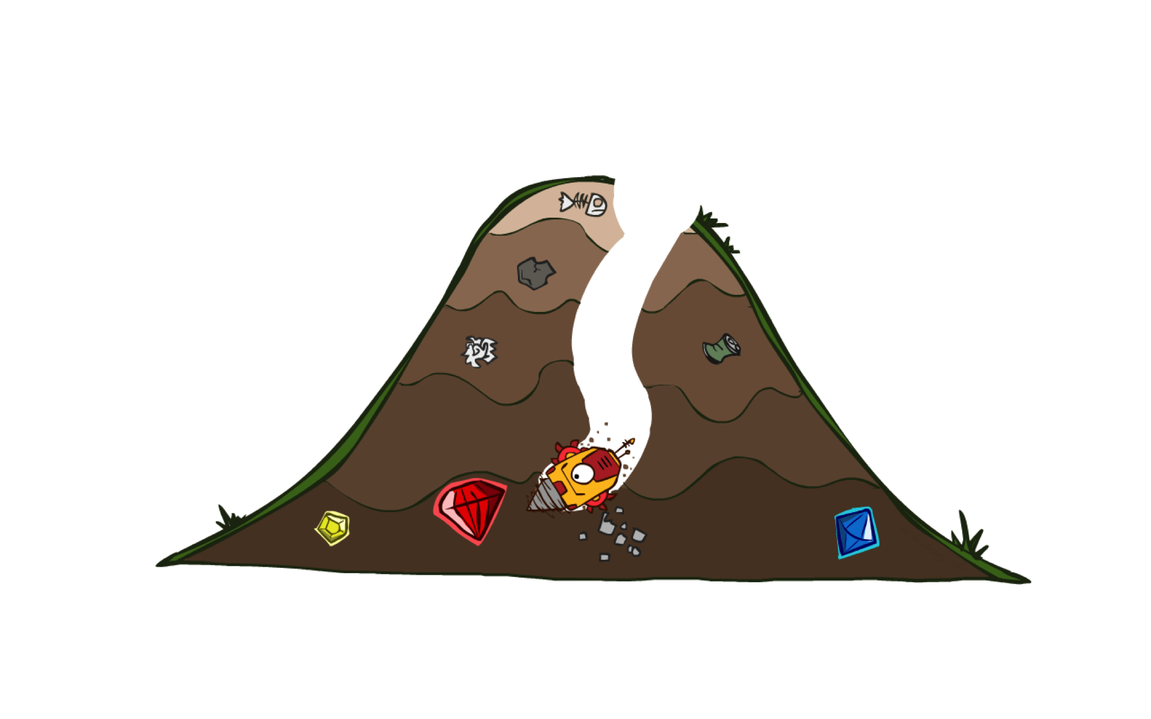
A* Search

Slide 25
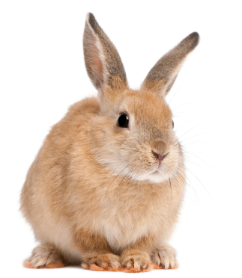
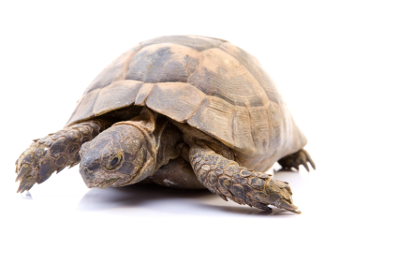
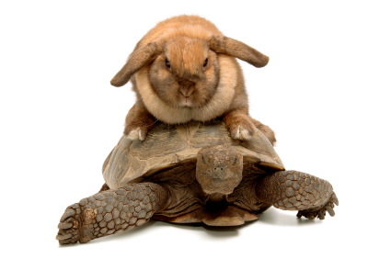
A* Search
UCS
Greedy
A*
Notes:
Notes: these images licensed from iStockphoto for UC Berkeley use.

Slide 26
Combining UCS and Greedy
Uniform-cost orders by path cost, or backward cost g(n)
Greedy orders by goal proximity, or forward cost h(n)
A* Search orders by the sum: f(n) = g(n) + h(n)
8
g = 0 h=6
S
e
h=1
g = 1 h=5
a
1
1
3
2
g = 2 h=6
g = 9 h=1
S
a
d
G
b
d
g = 4 h=2
e
h=6
1
h=5
h=2
h=0
1
g = 3 h=7
g = 6 h=0
g = 10 h=2
c
b
c
G
d
h=7
h=6
g = 12 h=0
G
Example: Teg Grenager
Notes:
Things to note here: in graph, edge cost (backward) vs node cost (forward)
In tree, both are node values (b/c nodes are paths)

Slide 27
When should A* terminate?
Should we stop when we enqueue a goal?
No: only stop when we dequeue a goal
h = 2
A
2
2
S
h = 3
h = 0
G
2
B
3
h = 1

Slide 28
Pancake A*
Heuristic 1: the number of the largest pancake that is still out of place
3
g(action)
h(state)
Start
4
4
2
3
2
0
3
3
4
Goal
4
3
3
4
4
2
4
3
3
2
2
4
3
Cost: 7
# Steps: 3
4
4
2
3
3

Slide 29
Pancake A*
Heuristic 2: how many pancakes are on top of a smaller pancake?
2
g(action)
h(state)
Start
1
4
2
3
2
0
1
3
1
Goal
4
1
3
2
2
1
1
3
2
2
2
3
Cost: 7
# Steps: 5
2
4
1
1
3

Slide 30
Pancake A*
Heuristic 3: All zeros (aka null heuristic)
0
g(action)
h(state)
Start
0
4
Reduced to UCS!
2
3
2
0
0
3
0
Goal
4
0
3
0
2
0
0
3
2
2
0
3
Cost: 7
# Steps: 7
0
4
0
0
3

Slide 31
Is A* Optimal?
h = 6
1
A
3
S
h = 7
G
h = 0
5
What went wrong?
Actual cost of bad path < estimated cost of optimal path
We need estimates to be less than actual costs!

Slide 32

Admissible Heuristics

Slide 33

Idea: Admissibility
Inadmissible (pessimistic) heuristics break optimality by trapping good plans on the fringe
Admissible (optimistic) heuristics slow down bad plans but never outweigh true costs

Slide 34


Admissible Heuristics
A heuristic h is admissible (optimistic) if:
where is the true cost to a nearest goal
Examples:
Coming up with admissible heuristics is most of what’s involved in using A* in practice.
4
15

Slide 35

Optimality of A* Tree Search

Slide 36


Optimality of A* Tree Search
Assume:
A is an optimal goal node
B is a suboptimal goal node
h is admissible
Claim:
A will exit the fringe before B
…

Slide 37


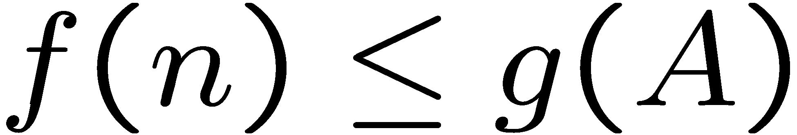
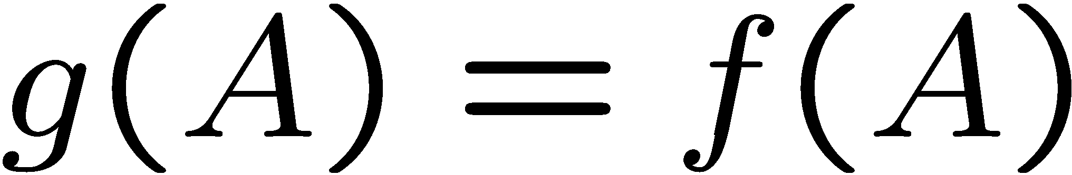
Optimality of A* Tree Search
Proof:
Imagine B is on the fringe
Some ancestor n of A is on the fringe, too (maybe A!)
Claim: n will be expanded before B
f(n) is less or equal to f(A)
g(n) = backward (path) cost
h(n) = forward (heuristic) cost
…
Definition of f-cost
Admissibility of h
h = 0 at a goal

Slide 38


Optimality of A* Tree Search
Proof:
Imagine B is on the fringe
Some ancestor n of A is on the fringe, too (maybe A!)
Claim: n will be expanded before B
f(n) is less or equal to f(A)
f(A) is less than f(B)
g(n) = backward (path) cost
h(n) = forward (heuristic) cost
…
B is suboptimal
h = 0 at a goal

Slide 39

Optimality of A* Tree Search
Proof:
Imagine B is on the fringe
Some ancestor n of A is on the fringe, too (maybe A!)
Claim: n will be expanded before B
f(n) is less or equal to f(A)
f(A) is less than f(B)
n expands before B
All ancestors of A expand before B
A expands before B
A* search is optimal
g(n) = backward (path) cost
h(n) = forward (heuristic) cost
…

Slide 40
Corollary: Optimality of UCS
A* search is optimal, given an admissible heuristic h
UCS is equivalent to A* with null heuristic h(n) = 0
Definitely admissible!
Therefore, UCS is also optimal.

Slide 41

Dijkstra vs UCS vs A*
Dijkstra’s algorithm – shortest path in a weighted graph
Starts with entire graph in priority queue (no fringe)
Uniform Cost Search – shortest path in a weighted graph
Only expands priority queue (fringe) as graph is traversed
Same time complexity, more memory efficient (in practice)
A*– shortest path in a weighted graph
Only expands priority queue (fringe) as graph is traversed
Uses heuristic to expand as few nodes as possible
Requires a good (admissible) heuristic!
In practice, both faster and more memory efficient

Slide 42
UCS vs A* Contours
Uniform-cost expands equally in all “directions”
A* expands mainly toward the goal, but does hedge its bets to ensure optimality
Start
Goal
Start
Goal
[Demo: contours UCS / greedy / A* empty (L3D1)]
[Demo: contours A* pacman small maze (L3D5)]

Slide 43

Video of Demo Contours (Empty) -- UCS

Slide 44
Video of Demo Contours (Empty) -- Greedy

Slide 45
Video of Demo Contours (Empty) – A*

Slide 46



Pacman Comparison
Greedy
Uniform Cost
A*

Slide 47
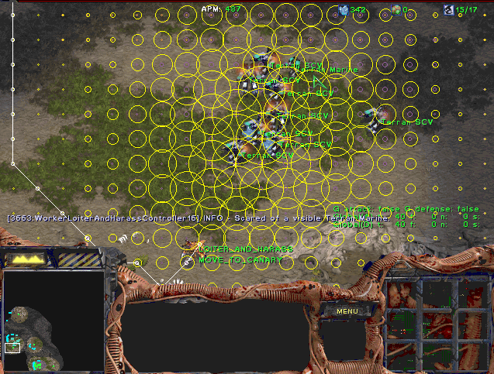
A* Applications
Video games
Pathing / routing problems
Resource planning problems
Robot motion planning
Language analysis
Machine translation
Speech recognition
…

Slide 48
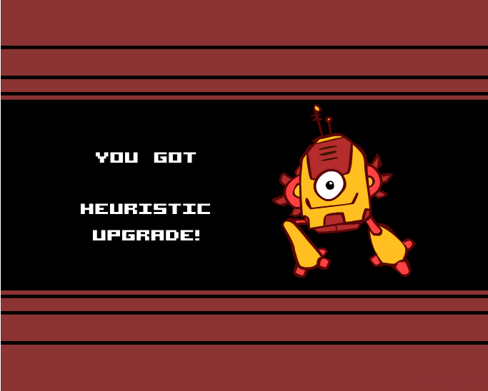
Creating Heuristics

Slide 49
Creating Admissible Heuristics
Most of the work in solving hard search problems optimally is in coming up with admissible heuristics
Often, admissible heuristics are solutions to relaxed problems, where new actions are available
366
15

Slide 50
Inadmissible heuristics can also be useful
Example: Driving from Cbus to Washington, DC
Goal: Reach DC, spending minimum gas money (path cost)
Path choices:
PA Turnpike – expensive toll, but relatively flat
Go through WVa, southern PA – no tolls, lots of hills
Heuristic: average highway mileage * path length
May overestimate cost (say I get a tailwind, or I’ve been driving through mountains a lot), but not enough to change my choices.

Slide 51

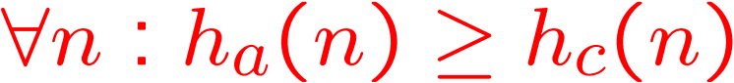
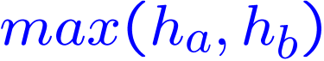

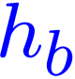


Trivial Heuristics, Dominance
Dominance: h_{a} ≥ h_{c} if
Heuristics form a semi-lattice:
Max of admissible heuristics is admissible
Trivial heuristics
Bottom of lattice is the zero heuristic (UCS)
Top of lattice is the exact heuristic
Notes:
Semi-lattice: x <= y <-> x = x ^ y (partially-ordered set with finite least upper bound)

Slide 52
Consistency of Heuristics
Main idea: estimated heuristic costs ≤ actual costs
Admissibility: heuristic cost ≤ actual cost to goal
h(A) ≤ actual cost from A to G
Consistency: heuristic “arc” cost ≤ actual cost for each arc
h(A) – h(C) ≤ cost(A to C)
Consequences of consistency:
The f value along a path never decreases
h(A) ≤ cost(A to C) + h(C)
A* graph search is optimal
A
1
C
h=4
h=1
h=2
3
G

Slide 53
Pancake Heuristics – Consistent?
Heuristic 1: the number of the largest pancake that is still out of place
3
g(action)
h(state)
4
4
2
3
Consistent!
2
0
3
3
4
4
3
3
4
4
2
4
3
3
2
2
4
3
4
4
2
3
3

Slide 54
Pancake Heuristics – Consistent?
Heuristic 2: how many pancakes are on top of a smaller pancake?
2
g(action)
h(state)
1
4
2
3
Not Consistent
2
0
1
3
1
4
1
3
2
2
1
1
3
2
2
2
3
2
4
1
1
3

Slide 55

A*: Summary

Slide 56
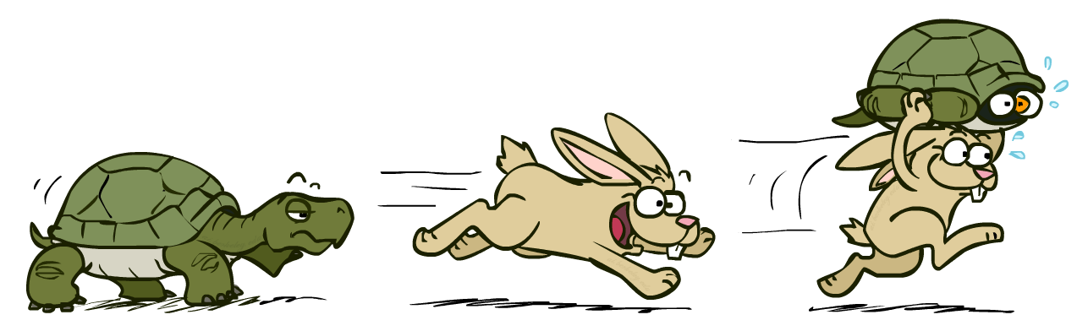
A*: Summary
A* uses both backward costs and (estimates of) forward costs
A* is optimal with admissible / consistent heuristics
Heuristic design is key: often use relaxed problems

Slide 57
Next Time
Adversarial search (competitive multi-agent problems)
Example search problem formulations

Slide 58

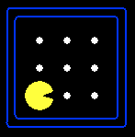





Search Problem Mechanics
A search problem consists of:
A state space
A successor function
(with actions, costs)
A start state and a goal test
A solution is a sequence of actions (a plan) which transforms the start state to a goal state
“N”, 1.0
“E”, 1.0
Notes:
State space may be fully or partially enumerated
Goal test – sometimes more than one state that satisfies having achieved the goal, for example, “eat all the dots”
Abstraction

